Slide 1
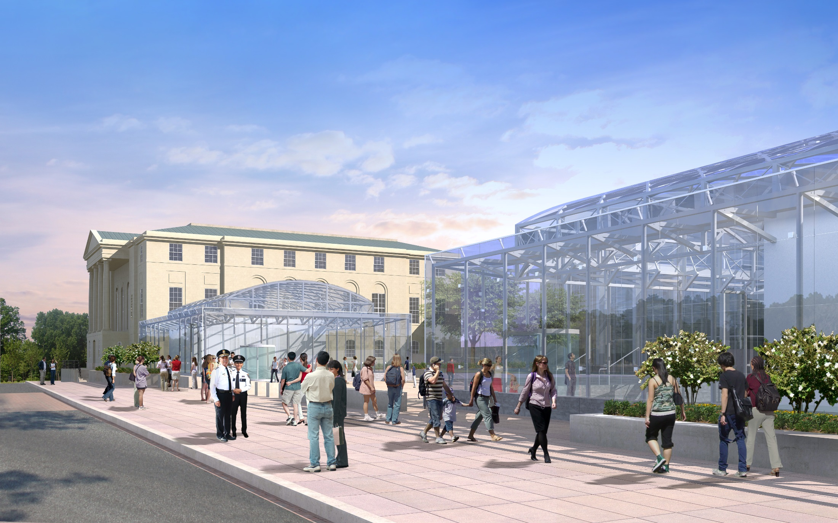
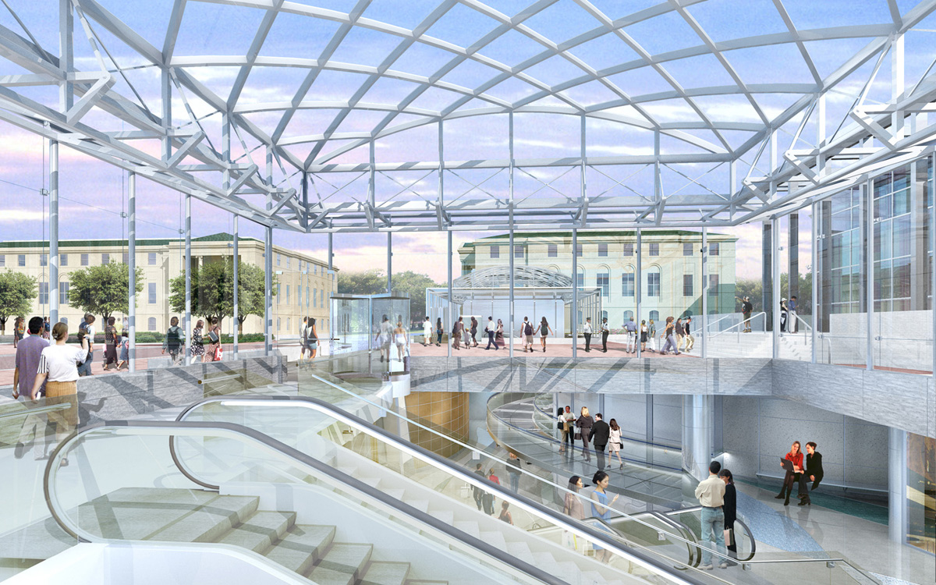
National Law Enforcement Officers Memorial Fund
Anya Godigamuwe | AE Senior Thesis | Mechanical | April 2015
Notes:
Good morning, everyone. My name is Anya Godigamuwe and today I will be presenting my thesis of the National Law Enforcement Museum in Washington, DC.

Slide 2
National Law Enforcement Museum
Introduction
Project Information
Mechanical System Redesign
Existing VAV System
Proposed VRF System
Pavilion Façade Redesign
Existing Façade
Proposed Façade
Acoustic Analysis
Conclusion
Acknowledgements
Notes:
Introduction – preview the different sections

Slide 3
National Law Enforcement Museum
Introduction
Project Information
Mechanical System Redesign
Existing VAV System
Proposed VRF System
Pavilion Façade Redesign
Existing Façade
Proposed Façade
Acoustic Analysis
Conclusion
Acknowledgements
Project Information
Location
Project Team
Construction & Cost
Schedule
Architecture
Notes:
Preview Project Information Section

Slide 4
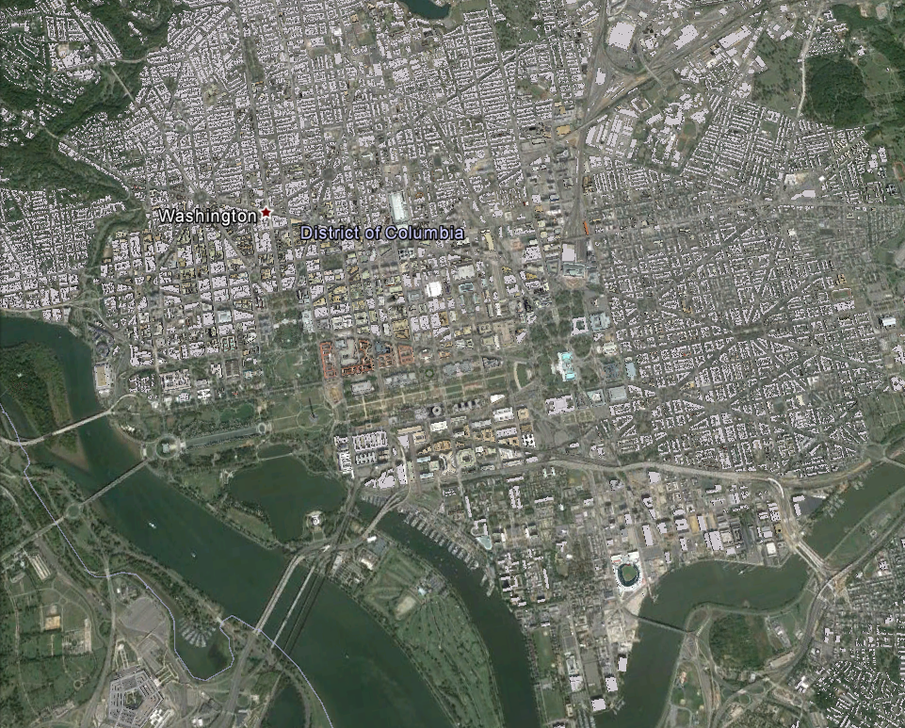
National Law Enforcement Museum
Introduction
Project Information
Mechanical System Redesign
Existing VAV System
Proposed VRF System
Pavilion Façade Redesign
Existing Façade
Proposed Façade
Acoustic Analysis
Conclusion
Acknowledgements
Washington, D.C.
Project Information
Location
Project Team
Construction & Cost
Schedule
Architecture
© Google Earth

Slide 5
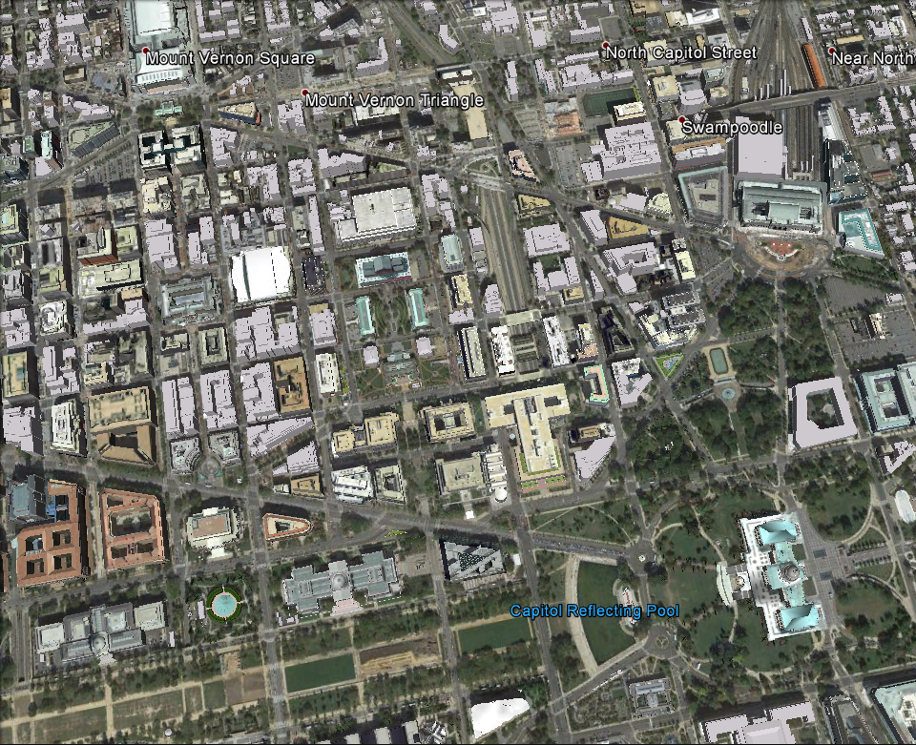
National Law Enforcement Museum
Introduction
Project Information
Mechanical System Redesign
Existing VAV System
Proposed VRF System
Pavilion Façade Redesign
Existing Façade
Proposed Façade
Acoustic Analysis
Conclusion
Acknowledgements
Project Information
Location
Project Team
Construction & Cost
Schedule
Architecture
US Capitol Building
© Google Earth

Slide 6
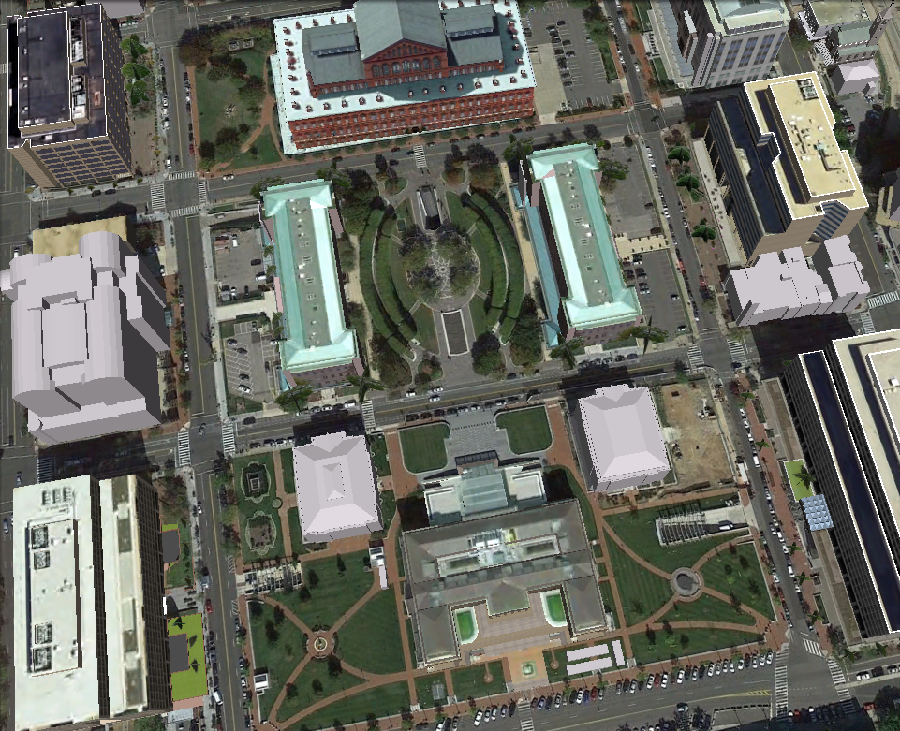
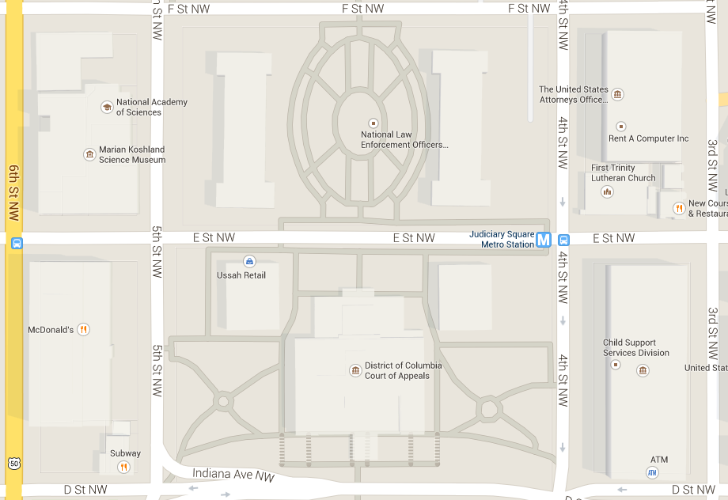
National Law Enforcement Museum
Introduction
Project Information
Mechanical System Redesign
Existing VAV System
Proposed VRF System
Pavilion Façade Redesign
Existing Façade
Proposed Façade
Acoustic Analysis
Conclusion
Acknowledgements
Project Information
Location
Project Team
Construction & Cost
Schedule
Architecture
© Google Earth

Slide 7
National Law Enforcement Museum
Project Information
Introduction
Project Information
Mechanical System Redesign
Existing VAV System
Proposed VRF System
Pavilion Façade Redesign
Existing Façade
Proposed Façade
Acoustic Analysis
Conclusion
Acknowledgements
Project Information
Location
Project Team
Construction & Cost
Schedule
Architecture
DC Court of Appeals
Museum Location
Nat’l Law Enforcement Officers Memorial
© Google Maps

Slide 8
National Law Enforcement Museum
Project Information
Introduction
Project Information
Mechanical System Redesign
Existing VAV System
Proposed VRF System
Pavilion Façade Redesign
Existing Façade
Proposed Façade
Acoustic Analysis
Conclusion
Acknowledgements
Project Team
Architect: Davis Buckley Architects & Planners
MEP: Loring Consulting Engineers
Structural: Spiegel, Zamecnik & Shah
Construction Manager: Clark Construction
Acoustic Consultant: Shen Milsom Wake
Lighting Consultant: Claude R. Engel
Landscape: Urban Tree + Soils
Project Information
Location
Project Team
Construction & Cost
Schedule
Architecture
Notes:
Project Team

Slide 9
National Law Enforcement Museum
Project Information
Introduction
Project Information
Mechanical System Redesign
Existing VAV System
Proposed VRF System
Pavilion Façade Redesign
Existing Façade
Proposed Façade
Acoustic Analysis
Conclusion
Acknowledgements
Construction, Cost & Schedule
Design – Bid – Build
Cost: $50 million
Mechanical Cost: $4.5 million
Schedule: 28 months
Summer 2015
Project Information
Location
Project Team
Construction & Cost
Schedule
Architecture

Slide 10
Architecture
Building: 54000 GSF
Two entry pavilions
Museum Spaces Underground
Research Center
Café
Gift Shop
Offices
Exhibit Spaces
Theater
Hall of Remembrance
Central Plant
National Law Enforcement Museum
Project Information
Introduction
Project Information
Mechanical System Redesign
Existing VAV System
Proposed VRF System
Pavilion Façade Redesign
Existing Façade
Proposed Façade
Acoustic Analysis
Conclusion
Acknowledgements
Architecture
Building: 54000 GSF
Two entry pavilions
Museum Spaces Underground
Research Center
Café
Gift Shop
Offices
Exhibit Spaces
Theater
Hall of Remembrance
Central Plant
Project Information
Location
Project Team
Construction & Cost
Schedule
Architecture
© Davis Buckley Architects & Planners

Slide 11
National Law Enforcement Museum
Project Information
Introduction
Project Information
Mechanical System Redesign
Existing VAV System
Proposed VRF System
Pavilion Façade Redesign
Existing Façade
Proposed Façade
Acoustic Analysis
Conclusion
Acknowledgements
Architecture
Building: 54000 GSF
Two entry pavilions
Museum Spaces Underground
Research Center
Café
Gift Shop
Offices
Exhibit Spaces
Theater
Hall of Remembrance
Central Plant
Project Information
Location
Project Team
Construction & Cost
Schedule
Architecture
© Davis Buckley Architects & Planners

Slide 12
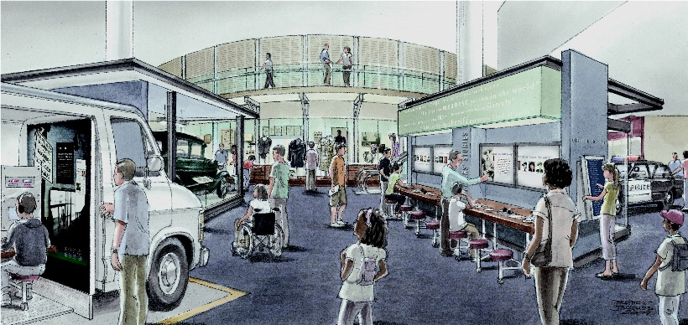
National Law Enforcement Museum
Project Information
Introduction
Project Information
Mechanical System Redesign
Existing VAV System
Proposed VRF System
Pavilion Façade Redesign
Existing Façade
Proposed Façade
Acoustic Analysis
Conclusion
Acknowledgements
Architecture
Building: 54000 GSF
Two entry pavilions
Museum Spaces Underground
Research Center
Café
Gift Shop
Offices
Exhibit Spaces
Theater
Hall of Remembrance
Central Plant
Project Information
Location
Project Team
Construction & Cost
Schedule
Architecture
Courtesy of NLEOMF

Slide 13
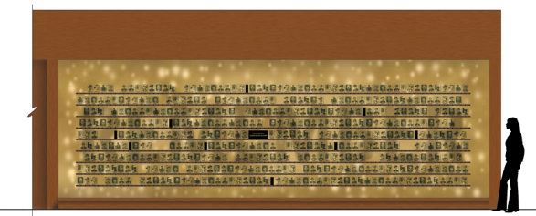
National Law Enforcement Museum
Project Information
Introduction
Project Information
Mechanical System Redesign
Existing VAV System
Proposed VRF System
Pavilion Façade Redesign
Existing Façade
Proposed Façade
Acoustic Analysis
Conclusion
Acknowledgements
Architecture
Building: 54000 GSF
Two entry pavilions
Museum Spaces Underground
Research Center
Café
Gift Shop
Offices
Exhibit Spaces
Theater
Hall of Remembrance
Central Plant
Project Information
Location
Project Team
Construction & Cost
Schedule
Architecture
Courtesy of NLEOMF

Slide 14
National Law Enforcement Museum
Introduction
Project Information
Mechanical System Redesign
Existing VAV System
Proposed VRF System
Pavilion Façade Redesign
Existing Façade
Proposed Façade
Acoustic Analysis
Conclusion
Acknowledgements
Depth One: Mechanical System Redesign

Slide 15
National Law Enforcement Museum
Depth: Mechanical System Redesign
Introduction
Project Information
Mechanical System Redesign
Existing VAV System
Proposed VRF System
Pavilion Façade Redesign
Existing Façade
Proposed Façade
Acoustic Analysis
Conclusion
Acknowledgements
Design Goals
Energy Efficiency
Minimum Noise
LEED Silver Status
Challenges
Humid Summer
Unobtrusive Design
Existing VAV System
Design Goals
Challenges
Equipment
Schematic
Heating & Cooling Loads

Slide 16
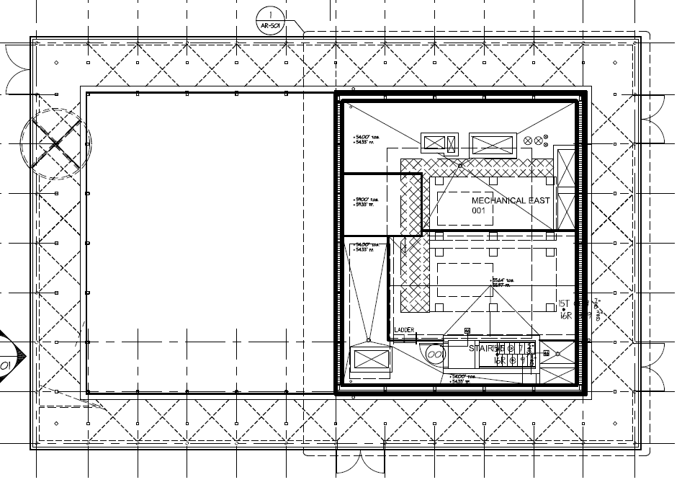
National Law Enforcement Museum
Depth: Mechanical System Redesign
Introduction
Project Information
Mechanical System Redesign
Existing VAV System
Proposed VRF System
Pavilion Façade Redesign
Existing Façade
Proposed Façade
Acoustic Analysis
Conclusion
Acknowledgements
Equipment
Mechanical Penthouse East
(1) Air Handling Unit
East Entry
(2) Cooling Towers
Chillers
Existing VAV System
Design Goals
Challenges
Equipment
Schematic
Heating & Cooling Loads
Equipment
Mechanical Penthouse East
(1) Air Handling Unit
East Entry
(2) Cooling Towers
Chillers

Slide 17
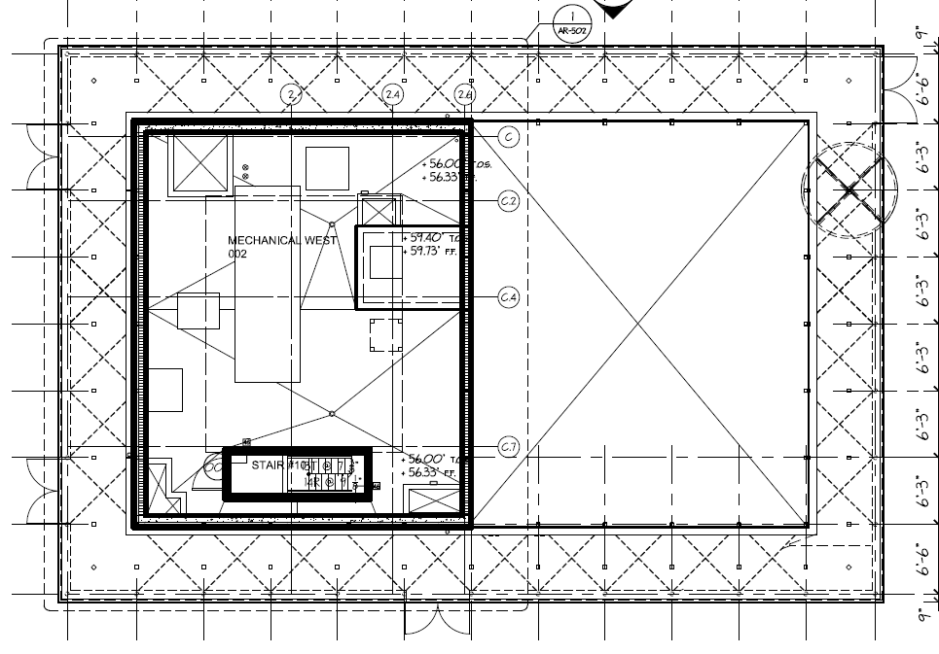
National Law Enforcement Museum
Depth: Mechanical System Redesign
Introduction
Project Information
Mechanical System Redesign
Existing VAV System
Proposed VRF System
Pavilion Façade Redesign
Existing Façade
Proposed Façade
Acoustic Analysis
Conclusion
Acknowledgements
Equipment
Mechanical Penthouse West
(1) Air Handling Unit
West Entry
Existing VAV System
Design Goals
Challenges
Equipment
Schematic
Heating & Cooling Loads
Equipment
Mechanical Penthouse West
(1) Air Handling Unit
West Entry

Slide 18
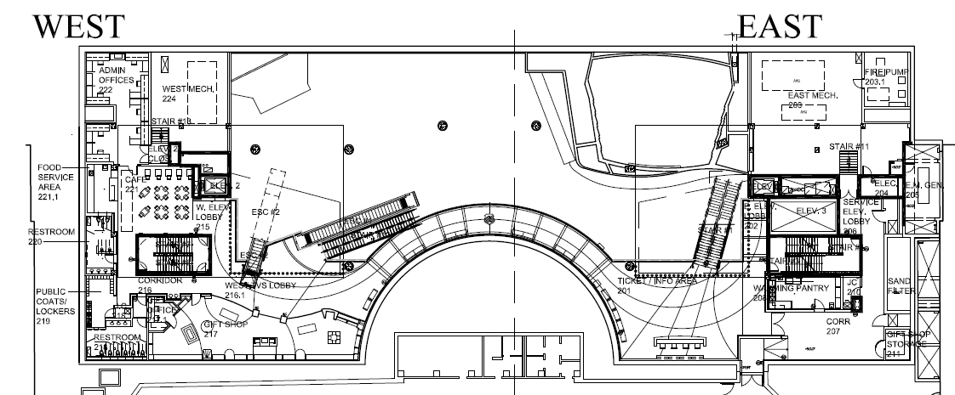
National Law Enforcement Museum
Depth: Mechanical System Redesign
Introduction
Project Information
Mechanical System Redesign
Existing VAV System
Proposed VRF System
Pavilion Façade Redesign
Existing Façade
Proposed Façade
Acoustic Analysis
Conclusion
Acknowledgements
Equipment
Mech. Rm. Ticket Level East
(2) Air Handling Units
Exhibits
Theater
Mech. Rm. Ticket Level West
(1) Air Handling Unit
Exhibits
Fan Coil Units
Existing VAV System
Design Goals
Challenges
Equipment
Schematic
Heating & Cooling Loads

Slide 19
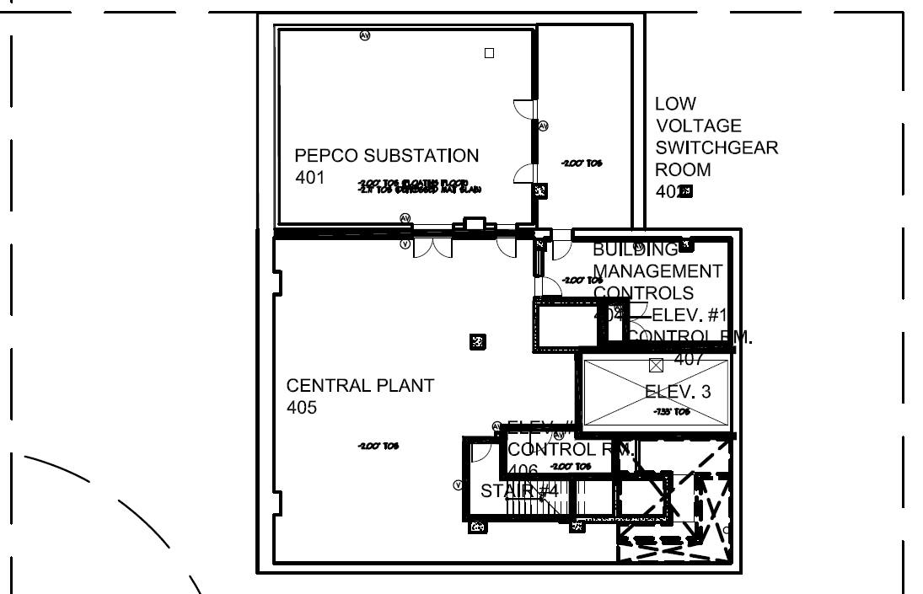
National Law Enforcement Museum
Depth: Mechanical System Redesign
Introduction
Project Information
Mechanical System Redesign
Existing VAV System
Proposed VRF System
Pavilion Façade Redesign
Existing Façade
Proposed Façade
Acoustic Analysis
Conclusion
Acknowledgements
Equipment
Central Plant
(1) Air Handling Unit
Pepco/Switchgear Rm.
(1) Chiller
(1) Heat Exchanger
(4) Pumps
(1) Expansion Tank
(1) CHW Buffer Tank
Existing VAV System
Design Goals
Challenges
Equipment
Schematic
Heating & Cooling Loads

Slide 20
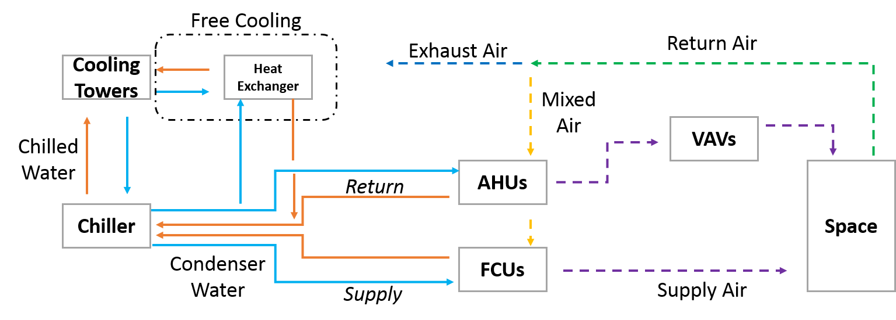
National Law Enforcement Museum
Depth: Mechanical System Redesign
Introduction
Project Information
Mechanical System Redesign
Existing VAV System
Proposed VRF System
Pavilion Façade Redesign
Existing Façade
Proposed Façade
Acoustic Analysis
Conclusion
Acknowledgements
Existing VAV System
Design Goals
Challenges
Equipment
Schematic
Heating & Cooling Loads

Slide 21
National Law Enforcement Museum
Depth: Mechanical System Redesign
Introduction
Project Information
Mechanical System Redesign
Existing VAV System
Proposed VRF System
Pavilion Façade Redesign
Existing Façade
Proposed Façade
Acoustic Analysis
Conclusion
Acknowledgements
Energy Costs | KWH | KBTU/YR
Heating | 142345 | 485825
Cooling | 186857 | 637742
Auxiliary Mechanical Equipment | 3954 | 13496
Lighting | 280914 | 958760
Receptacle Load | 559656 | 1910107
Existing VAV System
Design Goals
Challenges
Equipment
Schematic
Heating & Cooling Loads

Slide 22
National Law Enforcement Museum
Introduction
Project Information
Mechanical System Redesign
Existing VAV System
Proposed VRF System
Pavilion Façade Redesign
Existing Façade
Proposed Façade
Acoustic Analysis
Conclusion
Acknowledgements
Proposed Redesign – VRF System

Slide 23
National Law Enforcement Museum
Depth: Mechanical System Redesign
Introduction
Project Information
Mechanical System Redesign
Existing VAV System
Proposed VRF System
Pavilion Façade Redesign
Existing Façade
Proposed Façade
Acoustic Analysis
Conclusion
Acknowledgements
Reasoning
Less Energy
Lower Noise
Long Term Cost
Model
Trace 700
Zoning by Use
DOAS
Proposed VRF System
Reasoning
Model
Schematic
Heating & Cooling Loads
Annual Energy Use
Cost Analysis
Comparison
Conclusion

Slide 24
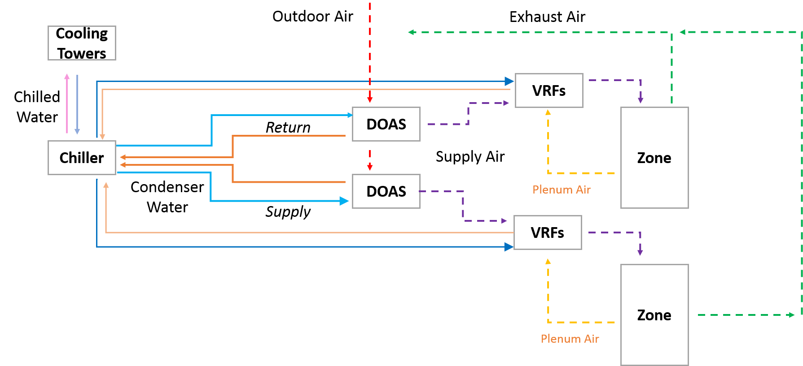
National Law Enforcement Museum
Depth: Mechanical System Redesign
Introduction
Project Information
Mechanical System Redesign
Existing VAV System
Proposed VRF System
Pavilion Façade Redesign
Existing Façade
Proposed Façade
Acoustic Analysis
Conclusion
Acknowledgements
Proposed VRF System
Reasoning
Model
Schematic
Heating & Cooling Loads
Annual Energy Use
Cost Analysis
Comparison
Conclusion

Slide 25
National Law Enforcement Museum
Depth: Mechanical System Redesign
Introduction
Project Information
Mechanical System Redesign
Existing VAV System
Proposed VRF System
Pavilion Façade Redesign
Existing Façade
Proposed Façade
Acoustic Analysis
Conclusion
Acknowledgements
Heating & Cooling Loads
VRF – 164 Cooling tons
27% less than VAV
VRF – 884 MBH
22% less than VAV
Proposed VRF System
Reasoning
Model
Schematic
Heating & Cooling Loads
Annual Energy Use
Cost Analysis
Comparison
Conclusion
Summary

Slide 26
National Law Enforcement Museum
Depth: Mechanical System Redesign
Introduction
Project Information
Mechanical System Redesign
Existing VAV System
Proposed VRF System
Pavilion Façade Redesign
Existing Façade
Proposed Façade
Acoustic Analysis
Conclusion
Acknowledgements
Annual Energy Use
VRF uses less energy in winter
Both system’s energy use is similar
Cannot choose one over other
Proposed VRF System
Reasoning
Model
Schematic
Heating & Cooling Loads
Annual Energy Use
Cost Analysis
Comparison
Conclusion

Slide 27
National Law Enforcement Museum
Depth: Mechanical System Redesign
Introduction
Project Information
Mechanical System Redesign
Existing VAV System
Proposed VRF System
Pavilion Façade Redesign
Existing Façade
Proposed Façade
Acoustic Analysis
Conclusion
Acknowledgements
Cost Analysis
Length of Life – Mitsubishi
3% expected discount rate 8.13% IRR
Proposed VRF System
Reasoning
Model
Schematic
Heating & Cooling Loads
Annual Energy Use
Cost Analysis
Comparison
Conclusion
Life Cycle Cost Estimate
Delta First Cost | $ 40,555.00
Net change in annual operating cost | $ 4,168.00
Simple Payback Period | 9.73
Length of life | 20 years
Discount Rate | 3%
Savings over life (20yrs @ 3%) | $ 62,009.29
Benefit to Cost Ratio | 1.53
Is BCR Cost effective? | YES
Internal Rate of Return | 8.13%

Slide 28
National Law Enforcement Museum
Depth: Mechanical System Redesign
Introduction
Project Information
Mechanical System Redesign
Existing VAV System
Proposed VRF System
Pavilion Façade Redesign
Existing Façade
Proposed Façade
Acoustic Analysis
Conclusion
Acknowledgements
Comparison
Similar operation to VAV
Less cooling energy, 6%
10 year payback period
Potential 5% reduction in CO2 emissions
Proposed VRF System
Reasoning
Model
Schematic
Heating & Cooling Loads
Annual Energy Use
Cost Analysis
Comparison
Conclusion
Alternative 1 & 2 Comparison
 | VAV | VRF | %Difference
CFM | 109761 | 106867 | 2.64%
KW | 1181926 | 1108271 | 6.23%
CO2 (lbm/yr) | 3265014 | 3090651 | 5.34%
SO2 (gm/yr) | 11672 | 11049 | 5.34%
NOX (gm/yr) | 4982 | 4716 | 5.34%

Slide 29
National Law Enforcement Museum
Depth: Mechanical System Redesign
Introduction
Project Information
Mechanical System Redesign
Existing VAV System
Proposed VRF System
Pavilion Façade Redesign
Existing Façade
Proposed Façade
Acoustic Analysis
Conclusion
Acknowledgements
Conclusion:
VRF is not a good option
Cost
Energy Use
Emissions
Proposed VRF System
Reasoning
Model
Schematic
Heating & Cooling Loads
Annual Energy Use
Cost Analysis
Comparison
Conclusion

Slide 30
National Law Enforcement Museum
Introduction
Project Information
Mechanical System Redesign
Existing VAV System
Proposed VRF System
Pavilion Façade Redesign
Existing Façade
Proposed Façade
Acoustic Analysis
Conclusion
Acknowledgements
Depth Two: Pavilion Façade Redesign

Slide 31
Challenges
Humid Summer
Unobtrusive Design
National Law Enforcement Museum
Depth: Pavilion Façade Redesign
Introduction
Project Information
Mechanical System Redesign
Existing VAV System
Proposed VRF System
Pavilion Façade Redesign
Existing Façade
Proposed Façade
Acoustic Analysis
Conclusion
Acknowledgements
Design Goals
Minimize Solar Heat Gain
Minimize Cooling Load
Depth: Pavilion Façade Redesign
Design Goals
Challenges
Proposal
Model
Solar Heat Gain
Cooling Load
Conclusion

Slide 32
Challenges
Humid Summer
Unobtrusive Design
National Law Enforcement Museum
Depth: Pavilion Façade Redesign
Introduction
Project Information
Mechanical System Redesign
Existing VAV System
Proposed VRF System
Pavilion Façade Redesign
Existing Façade
Proposed Façade
Acoustic Analysis
Conclusion
Acknowledgements
Challenges
Maintain Aesthetic
“minimize intrusion to surrounding square…strong and elegant…respectfully respond to the heavier mass…”
- DBA Website
Depth: Pavilion Façade Redesign
Design Goals
Challenges
Proposal
Model
Solar Heat Gain
Cooling Load
Conclusion
© Davis Buckley Architects & Planners

Slide 33
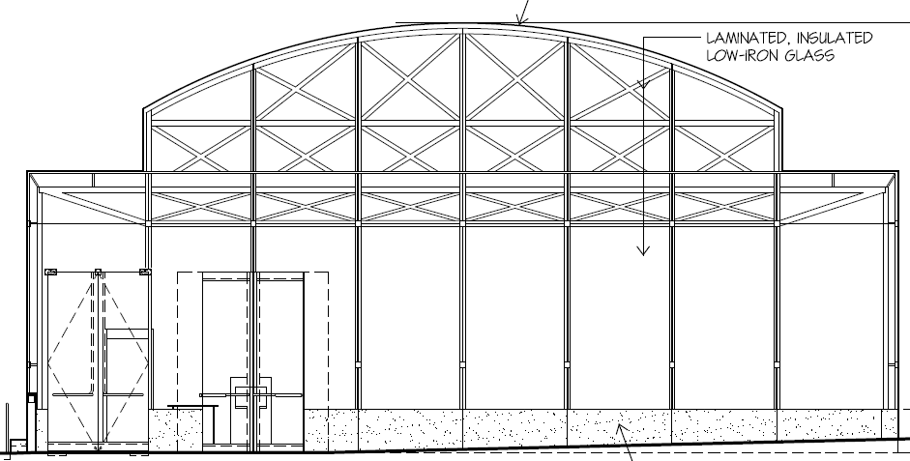
National Law Enforcement Museum
Depth: Pavilion Façade Redesign
Introduction
Project Information
Mechanical System Redesign
Existing VAV System
Proposed VRF System
Pavilion Façade Redesign
Existing Façade
Proposed Façade
Acoustic Analysis
Conclusion
Acknowledgements
Proposal
Replace roof
Utilize better curtain wall
Depth: Pavilion Façade Redesign
Design Goals
Challenges
Proposal
Model
Solar Heat Gain
Cooling Load
Conclusion

Slide 34
National Law Enforcement Museum
Depth: Pavilion Façade Redesign
Introduction
Project Information
Mechanical System Redesign
Existing VAV System
Proposed VRF System
Pavilion Façade Redesign
Existing Façade
Proposed Façade
Acoustic Analysis
Conclusion
Acknowledgements
Model
Trace 700 VAV Model
Alternative with new glass type
Compare with VAV design
Original Glass
Material | Description | Thickness (in.)
Outboard Lite | clear (low iron) heat tempered, heat soaked glass with Low Emissivity Coating on Number 2 Surface, and with flat ground and polished edges | 0.31
Air Space | Air | 0.5
Inboard Lite x2 | Clear (low iron) heat soaked glass laminated with 0.060" DuPont SentryGlass Plus structural interlayer with flat ground and polished edges | 0.625
Thickness |  | 1.50
Approximate U-Value |  | 0.31
Shading Coefficient |  | 0.50
Visible Transmissivity |  | 0.90
Proposed Viracon Glass
Material | Description | Thickness (in.)
Outer Layer | Insulating tempered glass with 30% silk screen coverage | 0.25
Air Space | Air | 0.5
Inner Layer | Tempered glass with low-E coating | .25
Thickness |  | 1.00
Approximate U-Value |  | 0.26
Shading Coefficient |  | 0.35
Visible Transmissivity |  | 0.55
Vertical Insulating Laminated Glass
Material | Description | Thickness (in.)
Outer Layer | Insulating tempered glass with 30% silk screen coverage | 0.25
Air Space | Air | 0.5
Inner Layer | Tempered glass with low-E coating | .25
Thickness |  | 1.00
Approximate U-Value |  | 0.26
Shading Coefficient |  | 0.35
Visible Transmissivity |  | 0.55
Depth: Pavilion Façade Redesign
Design Goals
Challenges
Proposal
Model
Solar Heat Gain
Cooling Load
Conclusion

Slide 35
National Law Enforcement Museum
Depth: Pavilion Façade Redesign
Introduction
Project Information
Mechanical System Redesign
Existing VAV System
Proposed VRF System
Pavilion Façade Redesign
Existing Façade
Proposed Façade
Acoustic Analysis
Conclusion
Acknowledgements
Solar Heat Gain
Peak Solar Load Comparison
Depth: Pavilion Façade Redesign
Design Goals
Challenges
Proposal
Model
Solar Heat Gain
Cooling Load
Conclusion

Slide 36
National Law Enforcement Museum
Depth: Pavilion Façade Redesign
Introduction
Project Information
Mechanical System Redesign
Existing VAV System
Proposed VRF System
Pavilion Façade Redesign
Existing Façade
Proposed Façade
Acoustic Analysis
Conclusion
Acknowledgements
Cooling Load
Cooling Load Comparison
Monthly Utility Cost
Depth: Pavilion Façade Redesign
Design Goals
Challenges
Proposal
Model
Solar Heat Gain
Cooling Load
Conclusion

Slide 37
National Law Enforcement Museum
Depth: Pavilion Façade Redesign
Introduction
Project Information
Mechanical System Redesign
Existing VAV System
Proposed VRF System
Pavilion Façade Redesign
Existing Façade
Proposed Façade
Acoustic Analysis
Conclusion
Acknowledgements
Conclusion
Façade change beneficial
Reduced energy cost
Aesthetic unharmed
Depth: Pavilion Façade Redesign
Design Goals
Challenges
Proposal
Model
Solar Heat Gain
Cooling Load
Conclusion

Slide 38
National Law Enforcement Museum
Introduction
Project Information
Mechanical System Redesign
Existing VAV System
Proposed VRF System
Pavilion Façade Redesign
Existing Façade
Proposed Façade
Acoustic Analysis
Conclusion
Acknowledgements
Breadth Topic: Acoustic Analysis

Slide 39
National Law Enforcement Museum
Breadth: Acoustic Analysis
Introduction
Project Information
Mechanical System Redesign
Existing VAV System
Proposed VRF System
Pavilion Façade Redesign
Existing Façade
Proposed Façade
Acoustic Analysis
Conclusion
Acknowledgements
Space Description
Giving face to loss
Tribute to fallen
Breadth Topic: Acoustic Analysis
Space Description
Design Goals
Criteria
Modeling Process
Results
Conclusion

Slide 40
National Law Enforcement Museum
Breadth: Acoustic Analysis
Introduction
Project Information
Mechanical System Redesign
Existing VAV System
Proposed VRF System
Pavilion Façade Redesign
Existing Façade
Proposed Façade
Acoustic Analysis
Conclusion
Acknowledgements
Design Goals
Purpose
Low “echo”
Speech intelligibility
Breadth Topic: Acoustic Analysis
Space Description
Design Goals
Criteria
Modeling Process
Results
Conclusion

Slide 41
National Law Enforcement Museum
Breadth: Acoustic Analysis
Introduction
Project Information
Mechanical System Redesign
Existing VAV System
Proposed VRF System
Pavilion Façade Redesign
Existing Façade
Proposed Façade
Acoustic Analysis
Conclusion
Acknowledgements
Criteria
Reverberation Time
Quality of sound
Speech intelligibility
Breadth Topic: Acoustic Analysis
Space Description
Design Goals
Criteria
Modeling Process
Results
Conclusion

Slide 42
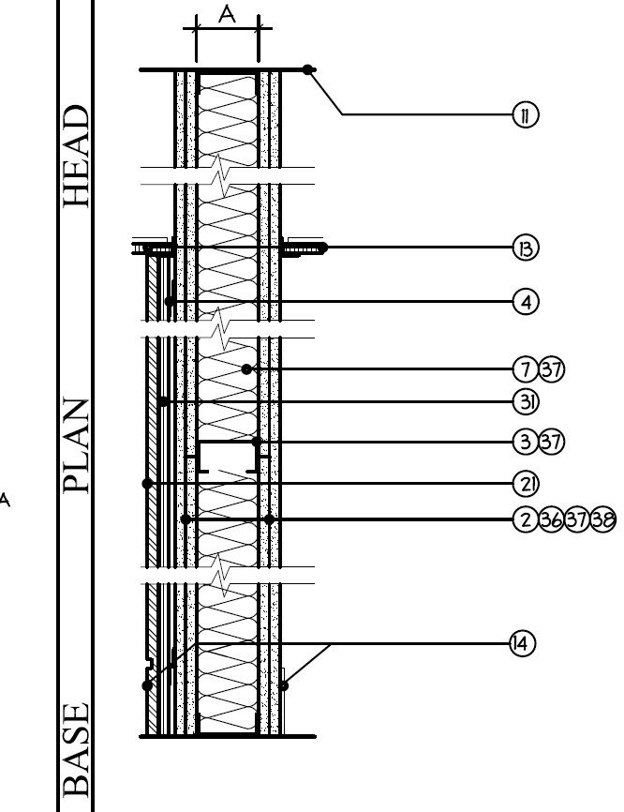
National Law Enforcement Museum
Breadth: Acoustic Analysis
Introduction
Project Information
Mechanical System Redesign
Existing VAV System
Proposed VRF System
Pavilion Façade Redesign
Existing Façade
Proposed Façade
Acoustic Analysis
Conclusion
Acknowledgements
Modeling Process
Absorption Values
Wall Area
RT value per octave band
Wall Type 37
Materials
Metal Panel system
5/8" medium density fiberboard
"Z" clips
2 layers 5/8" GWB
3-5/" insulation with metal studs at 16" OC
2 layers 5/8" GWB
Octave Band | Absorption Coefficient, α
125 | 0.1
250 | 0.07
500 | 0.05
1000 | 0.05
2000 | 0.04
4000 | 0.04
Breadth Topic: Acoustic Analysis
Space Description
Design Goals
Criteria
Modeling Process
Results
Conclusion

Slide 43
National Law Enforcement Museum
Breadth: Acoustic Analysis
Introduction
Project Information
Mechanical System Redesign
Existing VAV System
Proposed VRF System
Pavilion Façade Redesign
Existing Façade
Proposed Façade
Acoustic Analysis
Conclusion
Acknowledgements
Results
Room RT = 0.4 s.
Highest RT at 125 Hz
Architectural Acoustics: Principles & Design
Frequency | 125 | 250 | 500 | 1000 | 2000 | 4000
Reverberation Time (s) | 0.48 | 0.39 | 0.4 | 0.3 | 0.26 | 0.24
Breadth Topic: Acoustic Analysis
Space Description
Design Goals
Criteria
Modeling Process
Results
Conclusion

Slide 44
National Law Enforcement Museum
Breadth: Acoustic Analysis
Introduction
Project Information
Mechanical System Redesign
Existing VAV System
Proposed VRF System
Pavilion Façade Redesign
Existing Façade
Proposed Façade
Acoustic Analysis
Conclusion
Acknowledgements
Conclusion
This RT is good for space
Low frequency concern
Frequency | 125 | 250 | 500 | 1000 | 2000 | 4000
Reverberation Time (s) | 0.48 | 0.39 | 0.4 | 0.3 | 0.26 | 0.24
Breadth Topic: Acoustic Analysis
Space Description
Design Goals
Criteria
Modeling Process
Results
Conclusion

Slide 45
National Law Enforcement Museum
Conclusion
VRF System
Less energy use
Rate of return, 8.3%
Payback period, 10 years
Cost, $40,000 extra
Pavilion Facade
Less energy use
Lower cooling load
Acoustic Analysis
Meets criteria
RT of 0.4 s. ideal
Introduction
Project Information
Mechanical System Redesign
Existing VAV System
Proposed VRF System
Pavilion Façade Redesign
Existing Façade
Proposed Façade
Acoustic Analysis
Conclusion
Acknowledgements

Slide 46
National Law Enforcement Museum
Acknowledgements
My sincere thanks to:
Mr. J. Michael Galway - Loring Consulting Engineers
Mr. Davis Buckley & Mr. Thomas Striegel -
Davis Buckley Architects & Planners
Ms. Jeni Ashton - National Law Enforcement Museum
Mr. Lincoln Lawrence - Clark Construction Group
Dr. Stephen Treado & Prof. Stephen Parfitt
PSU Architectural Engineering Dept.
My loving family & friends
Introduction
Project Information
Mechanical System Redesign
Existing VAV System
Proposed VRF System
Pavilion Façade Redesign
Existing Façade
Proposed Façade
Acoustic Analysis
Conclusion
Acknowledgements
Thank you

Slide 47
National Law Enforcement Museum
Acknowledgements
My sincere thanks to:
Mr. J. Michael Galway - Loring Consulting Engineers
Mr. Davis Buckley & Mr. Thomas Striegel -
Davis Buckley Architects & Planners
Ms. Jeni Ashton - National Law Enforcement Museum
Mr. Lincoln Lawrence - Clark Construction Group
Dr. Stephen Treado & Prof. Stephen Parfitt
PSU Architectural Engineering Dept.
My loving family & friends
Introduction
Project Information
Mechanical System Redesign
Existing VAV System
Proposed VRF System
Pavilion Façade Redesign
Existing Façade
Proposed Façade
Acoustic Analysis
Conclusion
Acknowledgements
Thank you

Slide 48
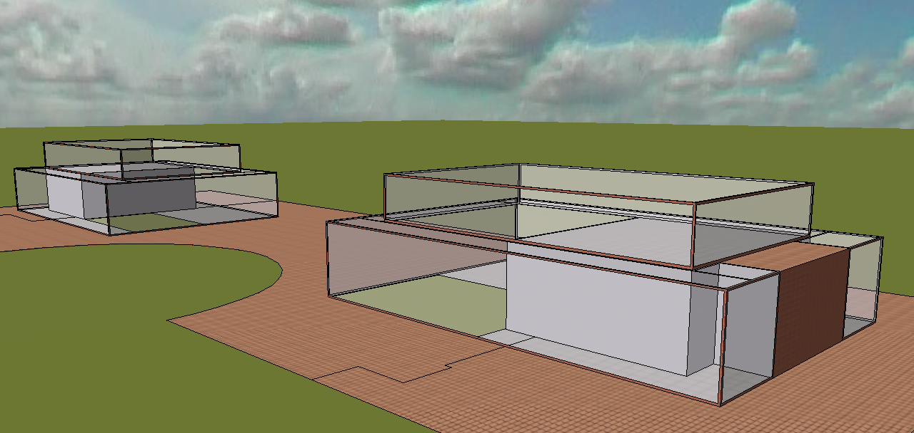
National Law Enforcement Museum
Appendix A - Daylighting
Appendices
A – Daylighting
B – VAV System
C – VAV/VRF Comparison
D – Façade Comparison
Criteria
IES Lighting Handbook
Model
IES Virtual Environment
RadienceIES
Breadth Topic: Daylighting Analysis
Model
Criteria
IES Results

Slide 49
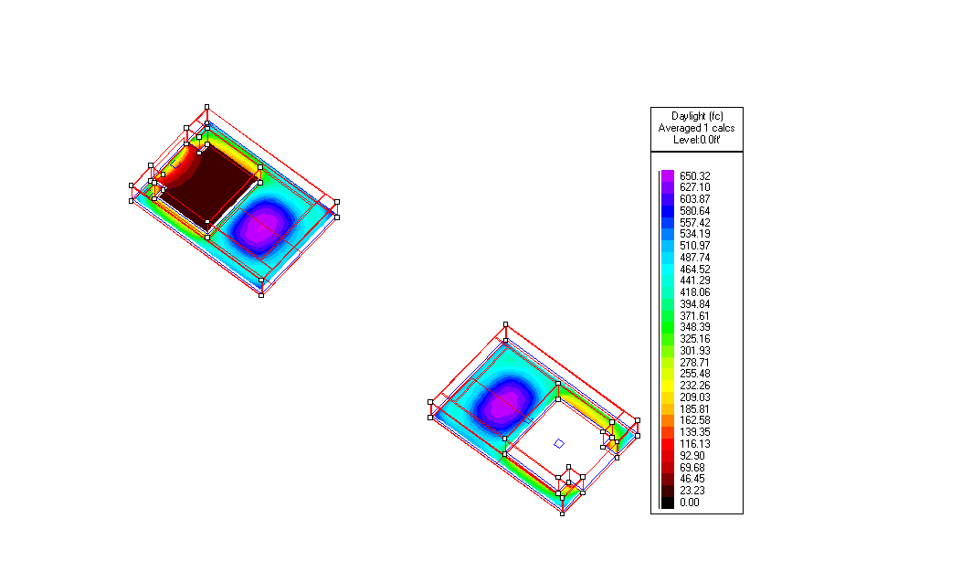
National Law Enforcement Museum
Appendix A - Daylighting
Appendices
A – Daylighting
B – VAV System
C – VAV/VRF Comparison
D – Façade Comparison
IES Results
Meet criteria of 100 lux
Breadth Topic: Daylighting Analysis
Model
Criteria
IES Results

Slide 50
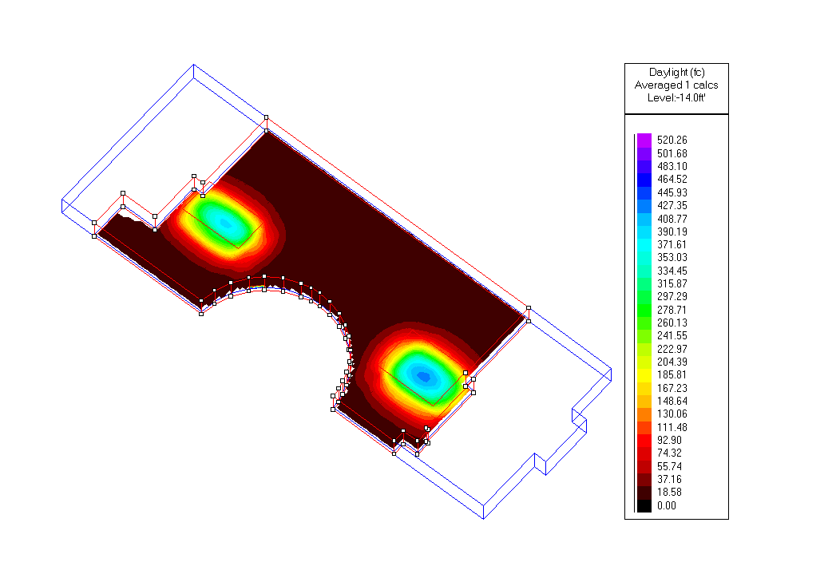
National Law Enforcement Museum
Appendix A - Daylighting
Appendices
A – Daylighting
B – VAV System
C – VAV/VRF Comparison
D – Façade Comparison
IES Results
Meet criteria of 100 lux
Breadth Topic: Daylighting Analysis
Model
Criteria
IES Results

Slide 51
National Law Enforcement Museum
Appendix B – VAV System
Appendices
A – Daylighting
B – VAV System
C – VAV/VRF Comparison
D – Façade Comparison
Energy Costs | KWH | KBTU/YR
Heating | 142345 | 485825
Cooling | 186857 | 637742
Auxiliary Mechanical Equipment | 3954 | 13496
Lighting | 280914 | 958760
Receptacle Load | 559656 | 1910107

Slide 52
National Law Enforcement Museum
Appendix C – VAV/ VRF Comparison
Appendices
A – Daylighting
B – VAV System
C – VAV/VRF Comparison
D – Façade Comparison

Slide 53
National Law Enforcement Museum
Appendix D – Façade Comparison
Appendices
A – Daylighting
B – VAV System
C – VAV/VRF Comparison
D – Façade Comparison

